Slide 1
Manufacturing Technology (ME461), Lecture 3
Date: 9/1/2018
Instructor: Shantanu Bhattacharya

Slide 2
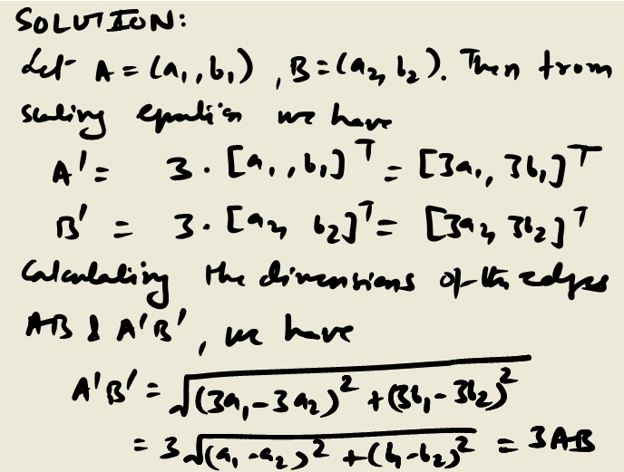
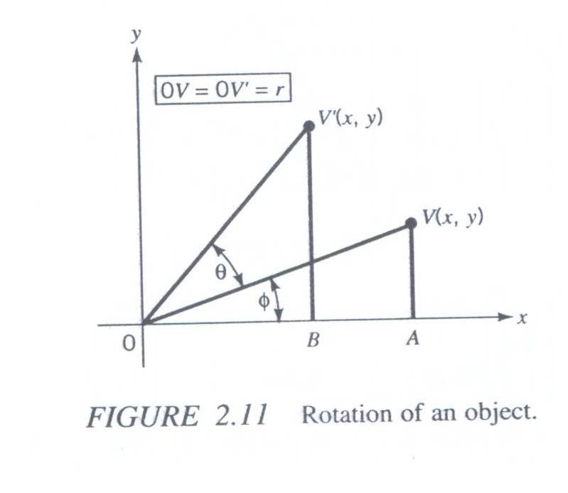
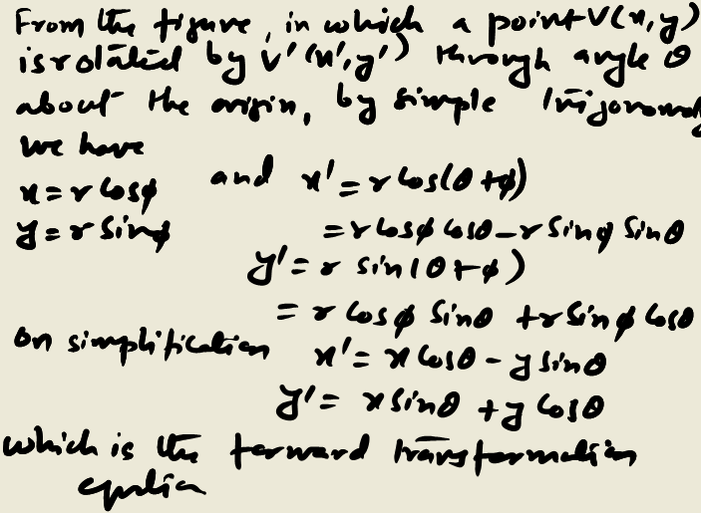
2-D transformation
Rotation:
Rotation in 2D space is defined as moving any point (x,y) of an object to a new position by rotating it through a given angle θ about some reference point. Positive angles are measured counterclockwise from x to y. The mathematical expression for the rotating transformation is not as obvious as the formulas for translation and scaling

Slide 3
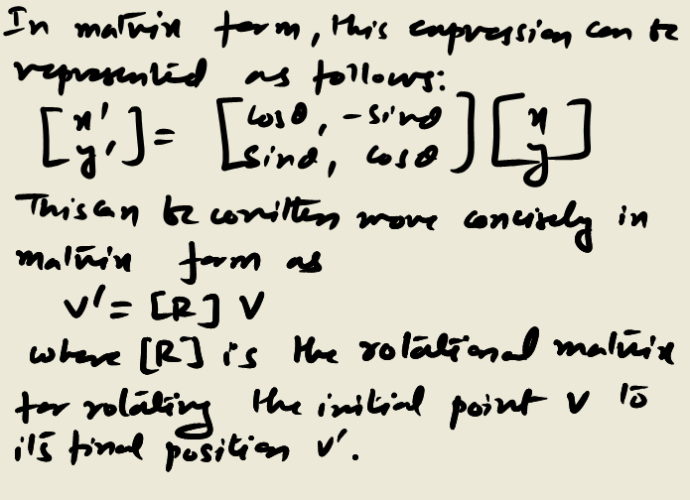
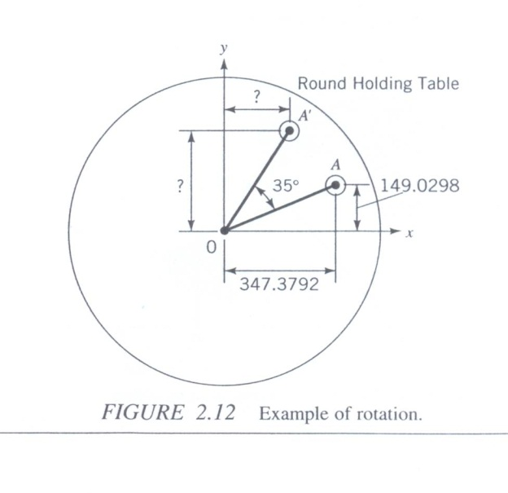
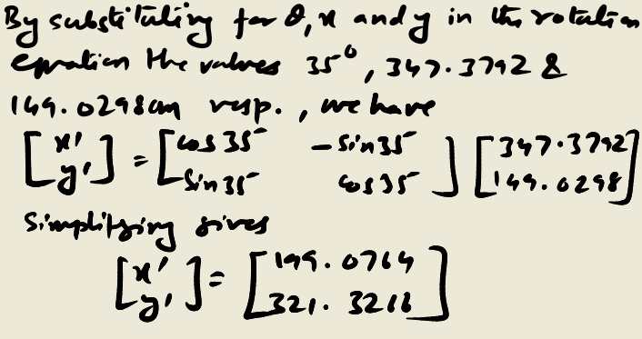
2-D transformation (Rotation)
Example: Determine the new position of object A placed on a round holding table after the table has been rotated by 35 deg.
Solution:

Slide 4
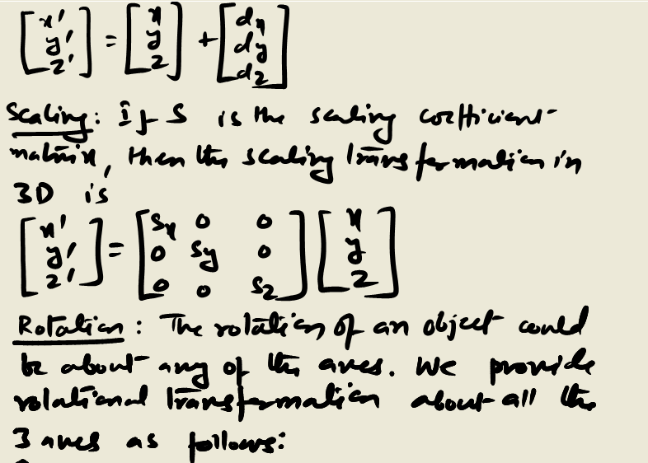

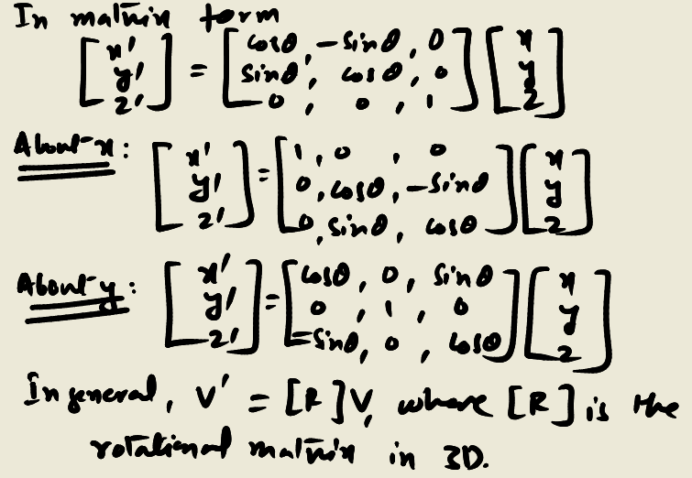
3-D transformation
3-D transformations are similar to 2-D transformations in both definition and derivation. We provide 3-D transformations in matrix form as follows:
Translation: In this case we translate a point V(x,y,z) by (dx, dy, dz) to point V’(x’,y’, z’). This can be expressed in matrix form as

Slide 5
Homogeneous transformation
Although the 2D and 3D transformations presented in the previous sections have obvious geometric meaning it is not efficient or economical to implement them on a computer.
This is because translation involves the addition of matrices whereas scaling and rotation involves multiplication.
It is however possible to implement a scheme involving only multiplication which would simplify the transformation process.

Slide 6
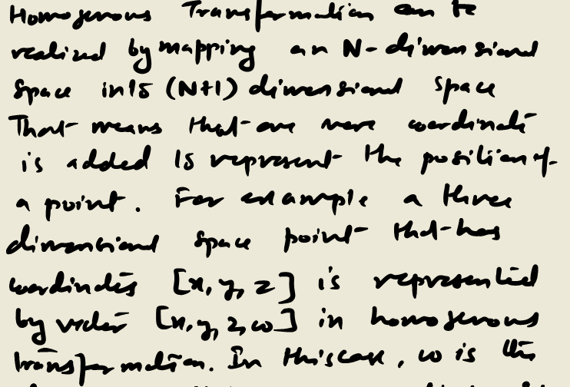
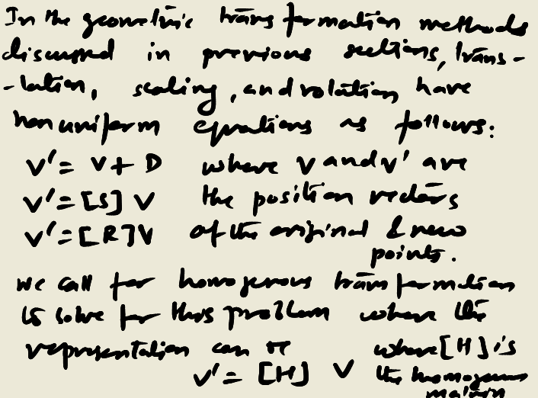

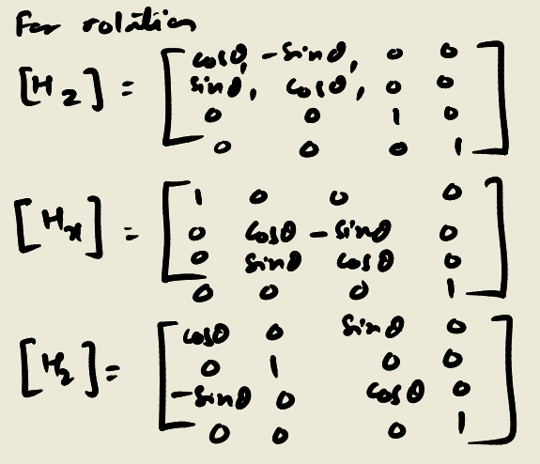
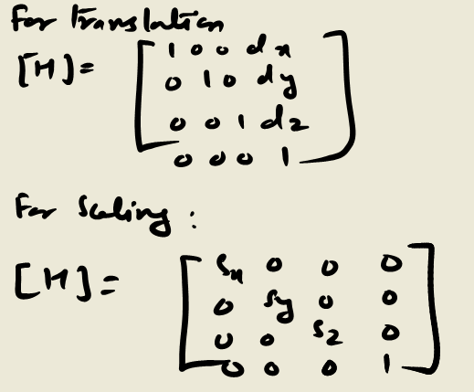
Homogeneous Transformation

Slide 7
Composition of Transformation
In practice, series of transformations may have to be applied to an object.
The techniques for combining series of transformation are very useful in these cases.
The final process of composition is accomplished by multiplying [H] matrix of various compositions. The process is also known are compounding or concatenation of [H].
V’= [Hn] [Hn-1] …………. [H1] V
Where n refers to the nth transformation in sequence.

Slide 8
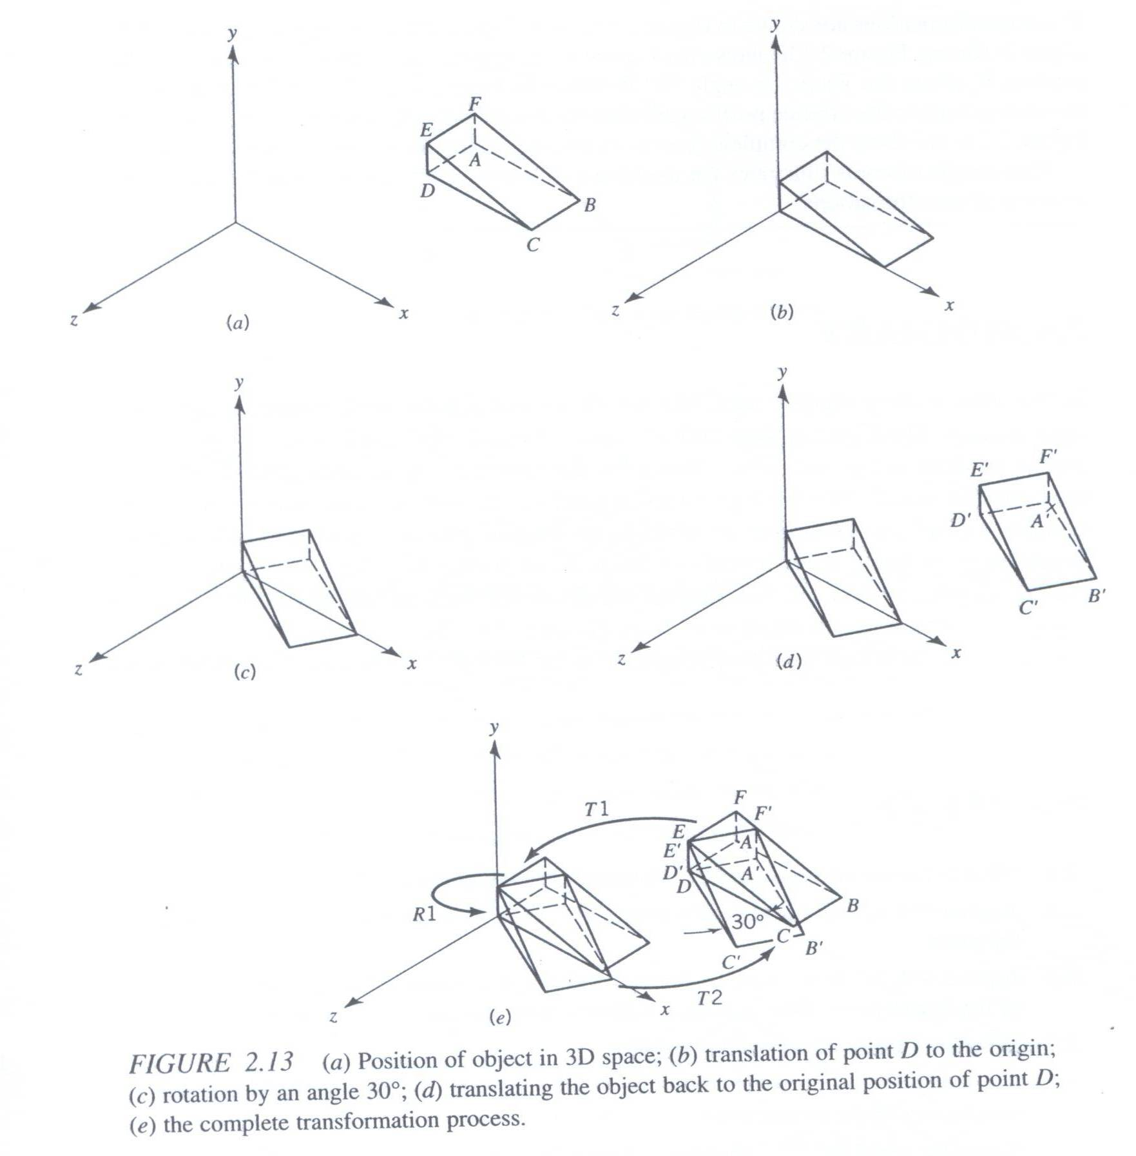
Example
Consider the 3D object shown on the left. The coordinates of the vertices are given as follows:
A= [3,5,3]
B=[7,5,3]
C=[7,5,5]
D=[3,5,5]
E=[3,6,5]
F=[3,6,3]
Rotate the 3D object by 30 deg. In clockwise direction at point D about the y-axis.

Slide 9
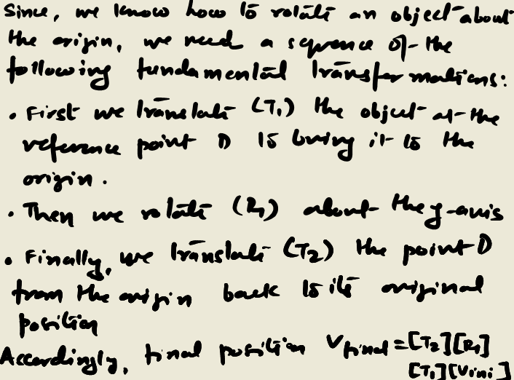
Solution

Slide 10
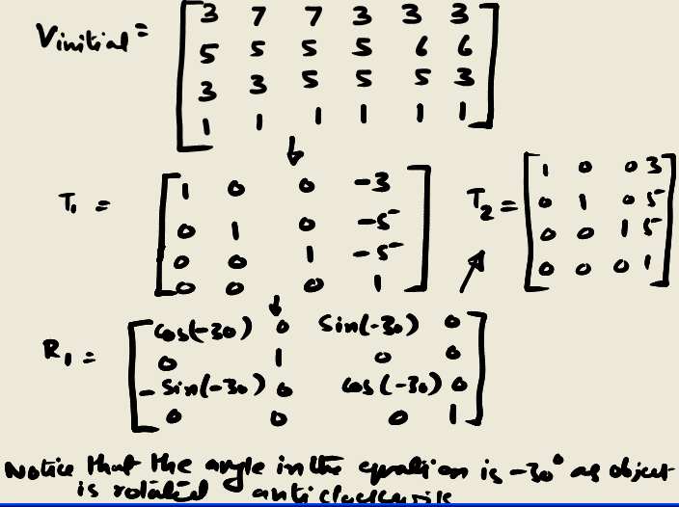
Solution

Slide 11
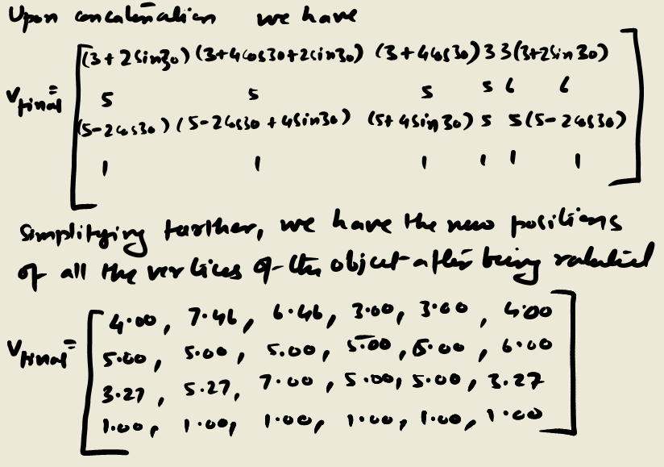
Solution

